Slide 1
Agenda Item 33 Preparations for XXIII INCOSAI
11th Meeting of KSC Steering Committee
Pampanga, Philippines
(12-14 June 2019)
SAI-India

Slide 2
Introduction
XXIII INCOSAI will be held in Moscow, Russia from 23-27 September 2019.
INCOSAI will hold three general plenary sessions, besides the 72nd and 73rd meetings of the INTOSAI Governing Board.
Congress will deliberate on two themes,
Theme I “Information technologies for the development of the public administration” under the chairmanship of the SAI of China”
Theme II “The role of the Supreme Audit Institutions in the achievement of the national priorities and goals”, led by SAI Russia.

Slide 3
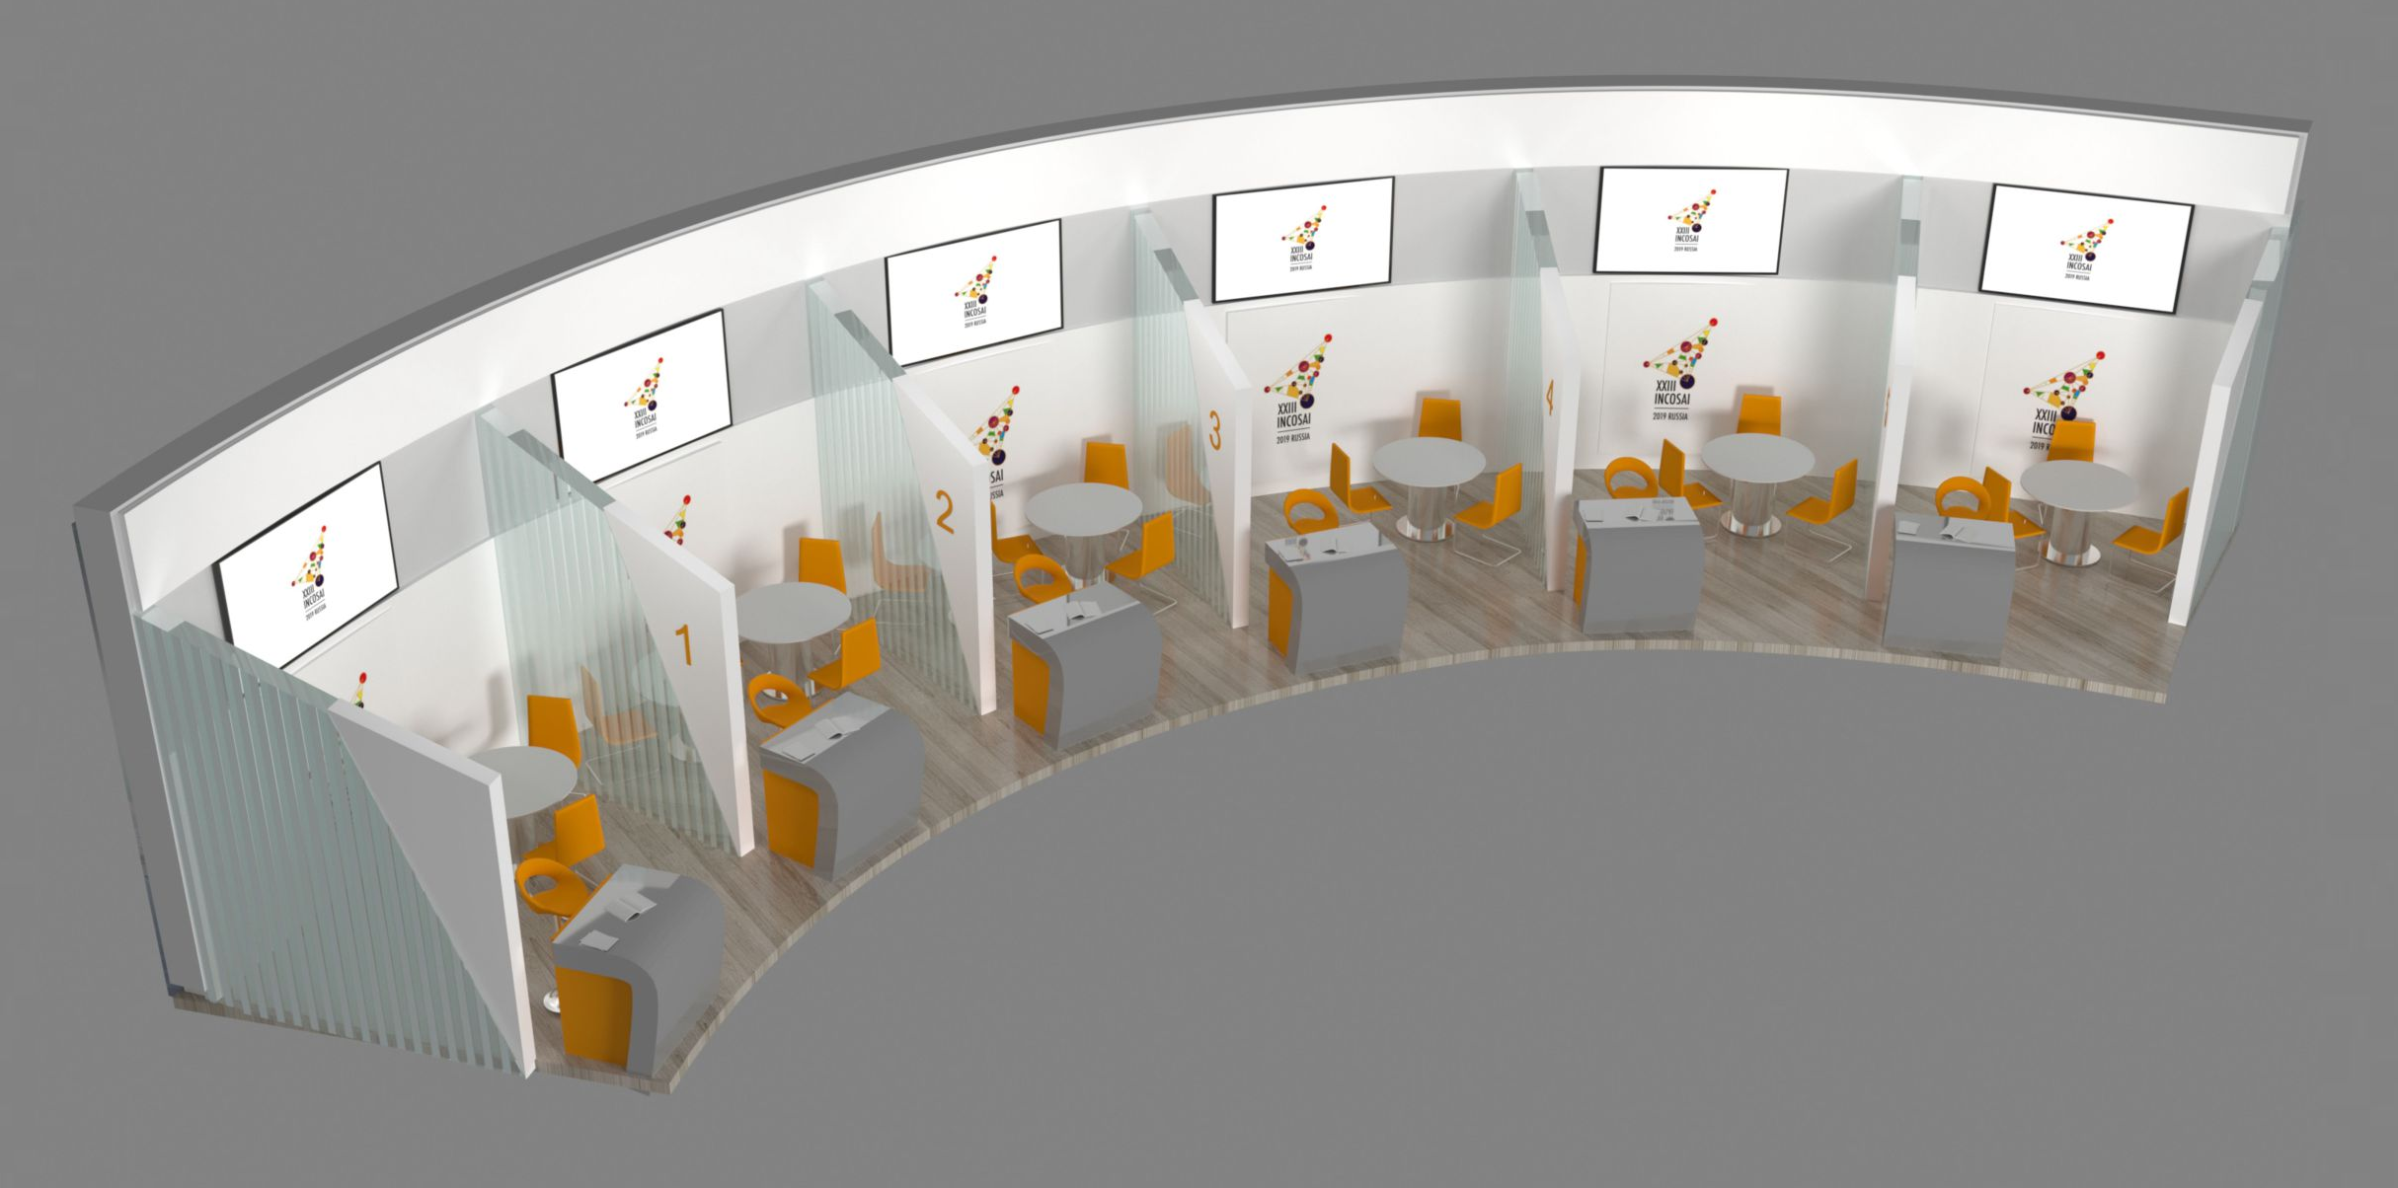
Concept of Booth
Last INCOSAI, for first time tried concept of Booths.
Booth provides small workspace devoted to showcasing the activities of the Goal committees and Working groups/subcommittees.
Booths can be used to provide detailed information on the subject matter, which could be in the form of talks, small presentations or questions and answer sessions.
It also provides the Chair and other relevant role-players a unique chance to receive feedback on the work they were doing.

Slide 4
Facilities offered
42 ’plasma panel connected to a laptop with Internet access via Wi-Fi, as well as USB-drives.
Booth provides for a Reception desk, Bar stool, desk and three office chairs.
Placing a logo for stand branding is possible only on a specified space.
Branding surface dimensions: 4120 mm x 750 mm.
To display logo on an information stand, a logo file in vector format to be sent e-mail: incosai2019@ach.gov.ru by August, 1, 2019.
Can use a laptop and a LCD panel during the presentation.
Participants can being roll-up displays.

Slide 5
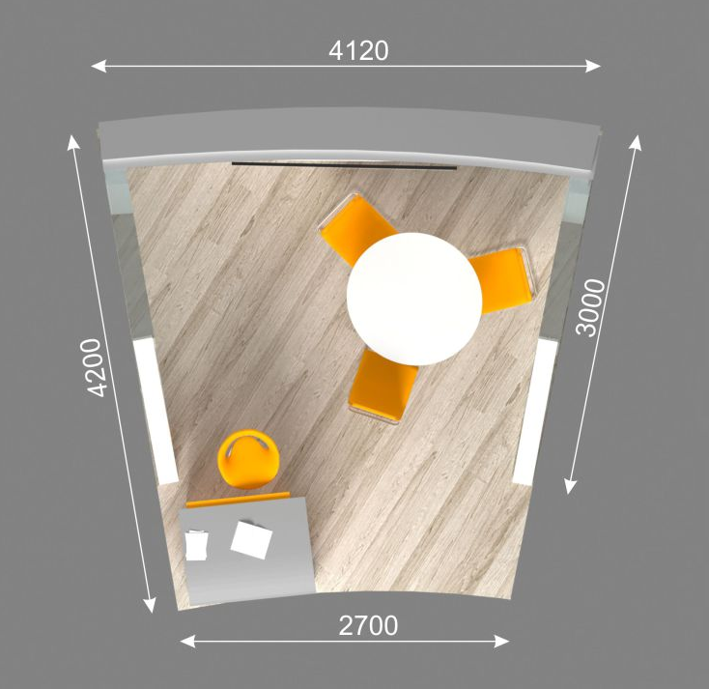
Booth Schedule
One booth allocated for KSC and its Working Groups
Booth will be open throughout Day 3, 4 and 5 (September 25 – 27).
Schedule 45 minutes every day for each Working Group
WGEI (SAI Uganda), WGKNI, WGPPA (SAI Russia), WGVBS (SAI Mexico), WGEPPP (SAI France) have expressed interest.
Response awaited from WGPD, WGFACML, WGFMRR, WGEA, and WGBD.
On receipt of response from all Working Groups, the Booth Schedule will be prepared by KSC Secretariat and conveyed to all Working Groups.

Slide 6
Other Activities
Main committee of KSC on Day 1 (23rd September) Forenoon.
In the Plenary, the KSC report will be presented in a very concise format as only 15 minutes have been provided present the report of KSC.
The Accounts Chamber of the Russian Federation is planning to organize Open Discussion on INTOSAI issues. Discussion will be held on 24th September after the 72nd Governing Board Meeting.
Four themes have been identified. Members may inform SAI Russia of their intention to join the above discussions along with the theme they are interested in

Slide 7
Issues for discussions
Working Groups KSC interested in requiring Booth space.
Suggestions on scheduling the Booth.
How the Working Groups will run the booths during the INCOSAI.

Slide 8
THANK YOU

